Slide 1
CSE350 Network Security
Assignment 2
Mohammed Kaif – 2020084
Arya Sinha - 2020498

Slide 2
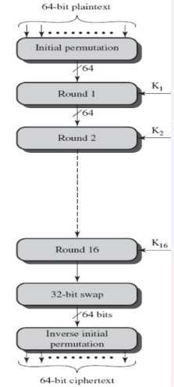
Project 0: DES encryption and decryption
The DES (Data Encryption Standard) algorithm consists of an initial permutation, 16 rounds of encryption, and a final permutation.
It encrypts a block of plaintext (64 bits) using a secret key (64 bits), and produces a ciphertext of the same size.

Slide 3
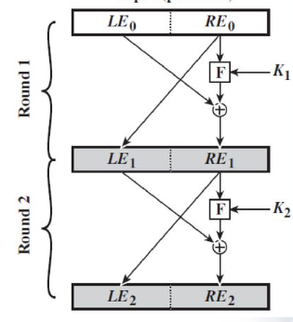
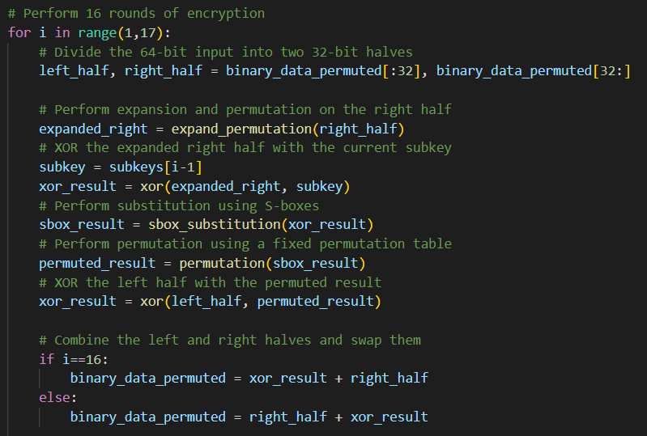
Round process
Each round consists of the following operations:
Key Transformation (Selecting 48 bit key from 56 bit key)
F-box transformation
XOR with other side (Swap)

Slide 4
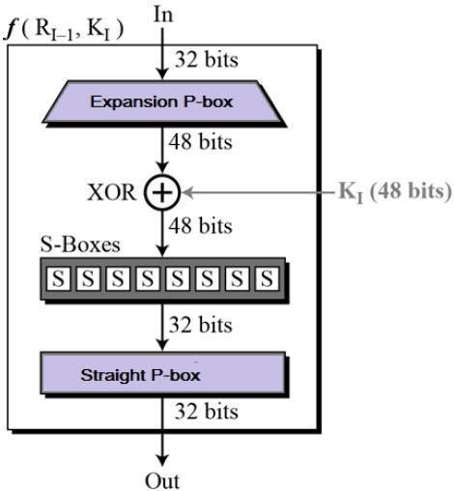
F-box
The F box in round i: F(R_{i-1}, K_{i}) consists of the following operations:
Expansion P box: expand from 32 bits to 48 bits, by duplicating 16 bits.
XOR 48-bits with 48-bit sub-key specific to round i, i.e. K_{i}
S-box substitution: This consists of 8 S-boxes (S_{i} ). Each takes a 6 bit input and transforms it to a 4 bit output using a table lookup.
Straight P box is a table based permutation. It permutes 32-bit input using a fixed P-box.
F-box has been implemented in the helper.py file.

Slide 5
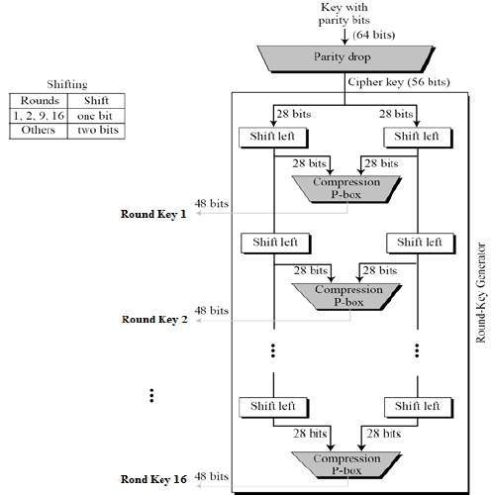
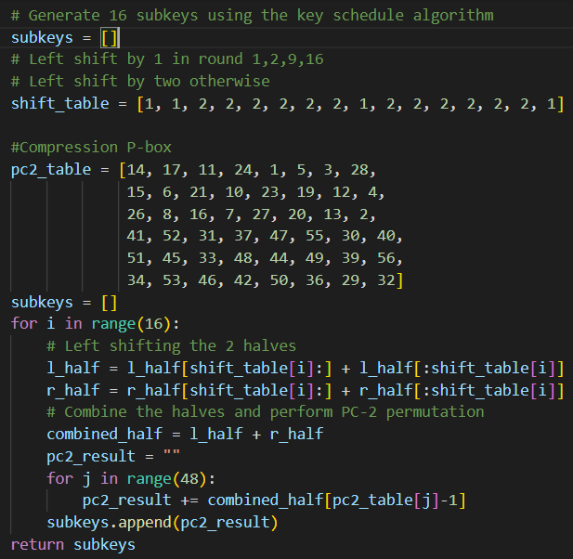
Key scheduling algorithm
Used to generate 16 subkeys
Implemented in subkey_gen.py
Parity-bit dropping using the pc1_table
Left shifting according to the round number
Compression using the pc2_table

Slide 6
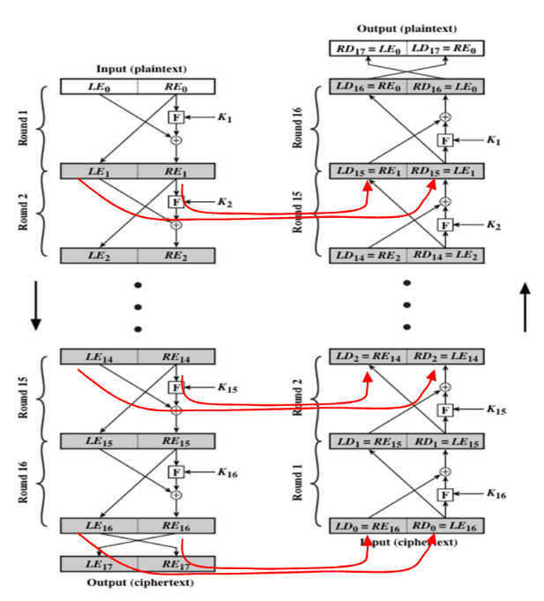
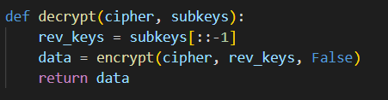
Decryption
The decryption process involves reversing the order of the subkeys and using them in the same operations as in encryption in reverse order.
The input to the decryption process is the ciphertext (encrypted binary data) of the same size as the plaintext (64 bits), and a list of subkeys that have been reversed from the original encryption process.

